Slide 1

Erd Document
By: Syed Bilal Ali
To: Sir Shakir

Slide 2
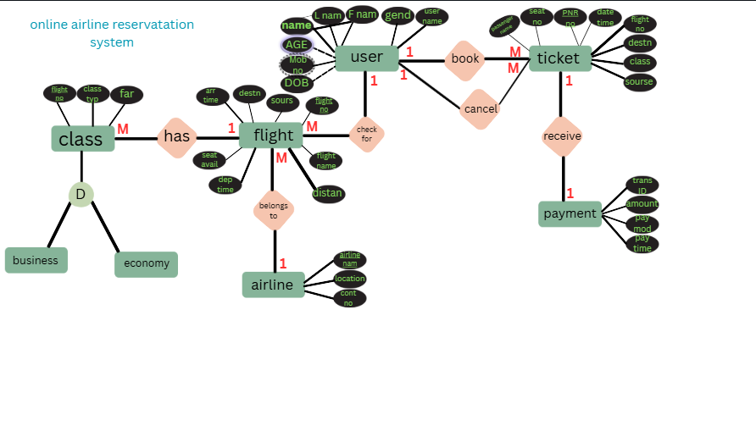

Slide 3
1. System Overview
The Online Airline Reservation System allows users to search, book, and manage flight tickets. It handles user profiles, ticketing, payments, flight schedules, airline details, and class types. The ER diagram models the core entities and their relationships to support efficient database design and system architecture.
2. Entities and Attributes
User
Attributes: user_id, name, age, gender, DOB
Description: Represents a customer using the system to book or cancel tickets and check flight availability.
Ticket
Attributes: ticket_id, date, time, class, source, destination
Description: Represents a flight reservation made by a user.
Payment
Attributes: payment_id, amount, method, pay_id, timing
Description: Records the financial transaction for a booked ticket.

Slide 4
Flight
Attributes: flight_id, flight_no, date, departure_time, arrival_time, distance
Description: Represents a scheduled flight operated by an airline.
Airline
Attributes: airline_id, name, location, contact_no
Description: Represents the company operating flights.
Class
Attributes: class_id, business, economy
Description: Represents the seating class options available on flights.

Slide 5
Relationships and Cardinalities
Relationship | Entities Involved | Cardinality | Description
book | User → Ticket | 1:M | A user can book multiple tickets
cancel | User → Ticket | 1:M | A user can cancel multiple tickets
check for | User → Flight | 1:M | A user can check multiple flights
receive | Ticket → Payment | M:1 | Each ticket receives one payment
belongs to | Flight → Airline | M:1 | Each flight is operated by one airline
has | Flight → Class | 1:M | Each flight offers multiple classes

Slide 6
Design Rationale
Normalization: Each entity is designed to avoid redundancy and support scalability.
Modularity: Entities like User, Flight, and Payment are decoupled for flexibility.
Real-world modeling: Relationships mirror actual airline operations (e.g., flights belong to airlines, tickets require payments).
Possible Enhancements
To further enrich the system, consider adding:
Airport entity for physical flight locations
Employee entity for airline staff
Luggage entity for baggage tracking
Passenger entity for multi-user bookings

